Slide 1
S8P1f. Recognize that there are more than 100 elements and some have similar properties as shown on the Periodic Table of Elements
How are elements organized on the Periodic Table?

Slide 2
Activating Strategy
Placement Pattern
[see resources]

Slide 3
Suppose you went to the video store and all the DVDs were mixed together. How could you tell the comedies from the action movies? If the videos were not arranged in a pattern, you wouldn’t know what kind of movie you had chosen!

Slide 4
Background Information
Scientists in the early 1860s had a similar problem like the mixed up DVDs when looking at Elements.
Dmitri Mendeleev discovered a pattern to the Elements in 1869.
Mendeleev found that when elements were arranged by similar properties, the pattern was “periodic” (repeating every seven elements). Therefore, the name The Periodic Table of Elements.

Slide 5
During the lesson, use the “Elements on the Periodic Table Notes” to record your information.

Slide 6
What is the Periodic Table?
It represents our understanding of the structure and usefulness of the atoms that have been identified in our environment
Elements are organized on the Periodic Table based on similar properties
Picture from www.chem4kids.com

Slide 7
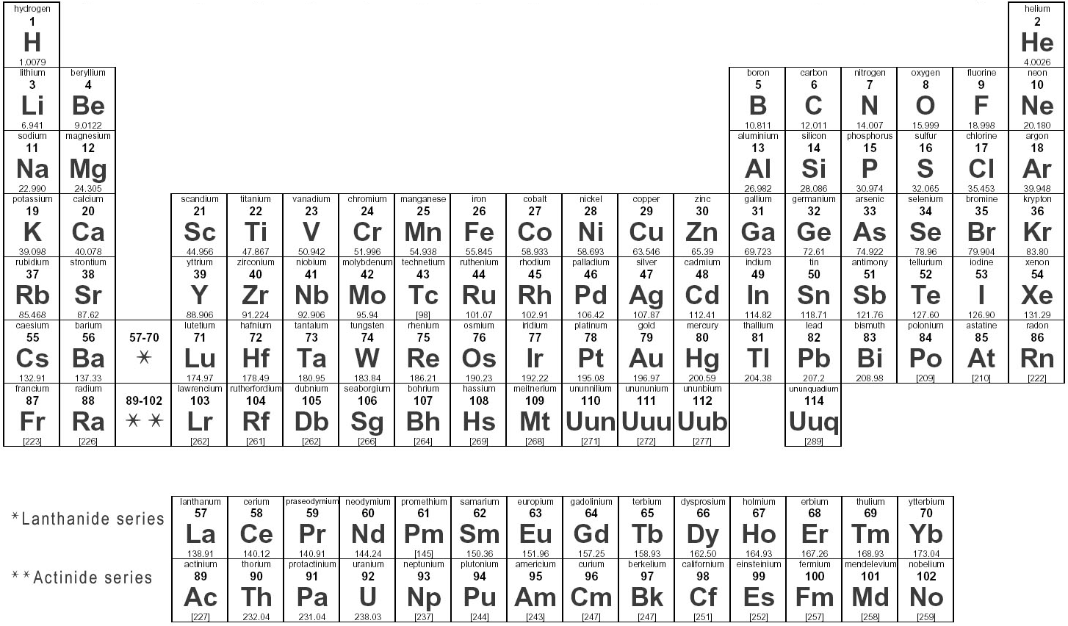
The Periodic Table contains over 100 different Elements

Slide 8
What do the numbers and Letters mean?

Slide 9
What do the numbers and Letters mean?
Element Name
Atomic Number:
The number of protons in its atom.
Atomic Number
Element’s Chemical Symbol
Atomic Mass:
The mass of one atom of the element
Atomic Mass

Slide 10
What do you notice about the Atomic Number of Elements as you move Left to Right, Up to Down on the Periodic Table of Elements?
The Atomic Mass Increases

Slide 11
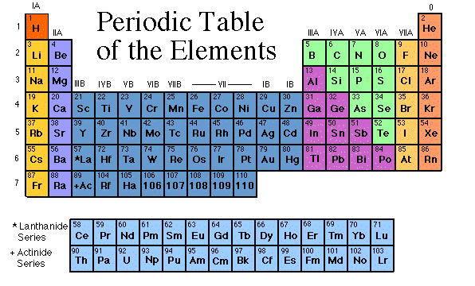
So how is the Periodic Table arranged?
The Periodic Table is organized like a big grid.
The properties of an element can be predicted from its location in the Periodic Table
There are rows (left to right) and columns (up and down). Each row and column mean something different.

Slide 12
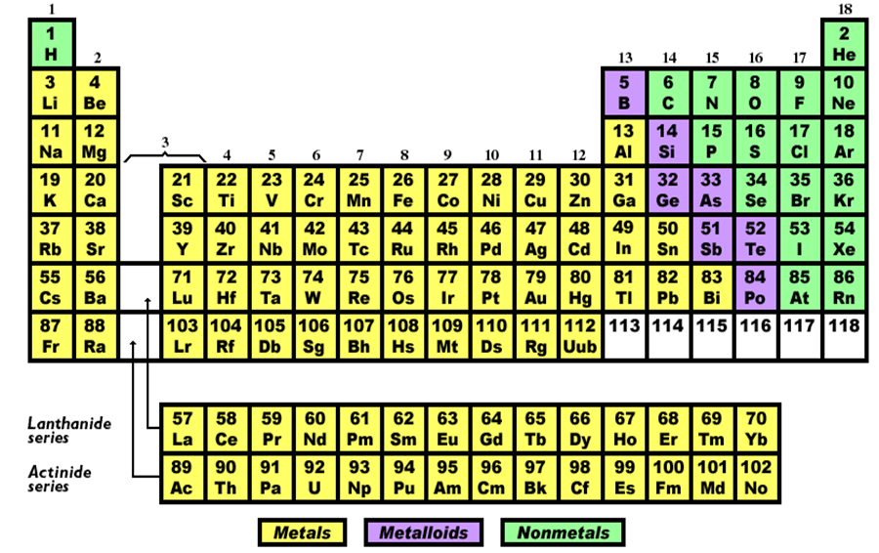
The Periodic Table can also be divided into three main types of Elements: Metals, Metalloids, and Nonmetals
Complete #13 on your Notes Sheet

Slide 13
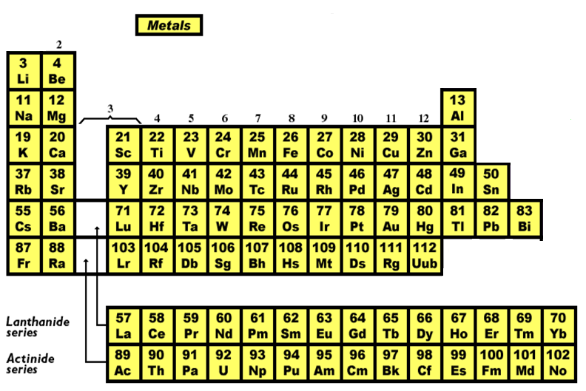
Metals
Metals are shiny
Metals are solid at room temperature
Metals have high conductivity
Metals can be flattened and not shatter (malleable)

Slide 14
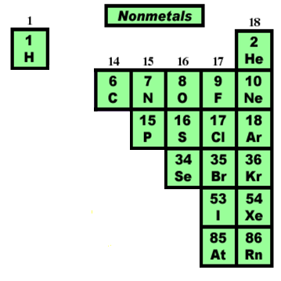
Nonmetals
Nonmetals are not shiny
Nonmetals are mostly gaseous at room temperature
Nonmetals are poor conductors
Nonmetals are brittle and will shatter easily (not malleable or ductile)

Slide 15
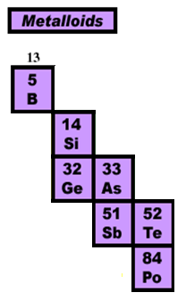
Metalloids
Metalloids have characteristics between metals and nonmetals
Metalloids are solid at room temperature
Metals are semi-conductors

Slide 16
Distributed Summarizing
Turn to a seat partner and discuss the following questions [without looking at your notes]:
Give a general description of the location of Metals, Nonmetals, and Metalloids on the Periodic Table
Most Elements are of which type?
What are some of the differences/similarities between them?

Slide 17
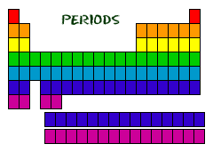
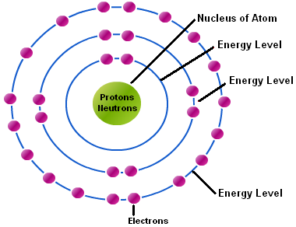
Periods
Each horizontal row of the table is called a period
Each row represents the number of energy levels present in an atom of the element

Slide 18
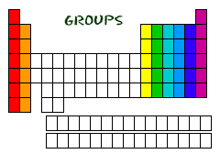
Groups (Families)
The Columns are called Groups
There are 18 groups
The Elements in a group have the same number of electrons in their outer energy level
Groups are often “grouped” together to form Families because of similar properties

Slide 19
You probably know a family with several members who look a lot alike. The Elements in a group or family in the periodic table often-but not always-have similar properties. Although you are not expected to know the names of the similar “family groups”, here is a quick glance. [Names vary depending on source]
Groups (Families)

Slide 20
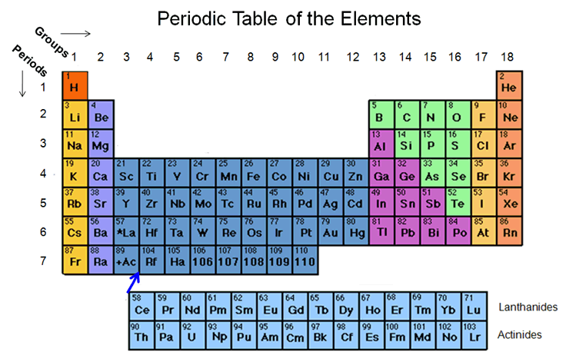
Complete #14 on your Notes

Slide 21
Hydrogen
The properties of Hydrogen do not match the properties of any single group, so it is set apart. It is above Group 1 because it has 1 electron in its outer energy level like Group 1.

Slide 22
Alkali Metals

Slide 23
Alkaline-Earth Metals

Slide 24
Transition Metals

Slide 25
Boron Group

Slide 26
Carbon Group

Slide 27
Nitrogen Group

Slide 28
Oxygen Group

Slide 29
Halogen Group

Slide 30
Noble Gases

Slide 31
Rare Earth Elements

Slide 32
Distributed Summarizing
It is tough to remember the difference between a Period and a Group on the Periodic Table.
With a partner, come up with a strategy for remembering the difference between a Period and a Group. Keep in mind the similar properties of each.

Slide 33
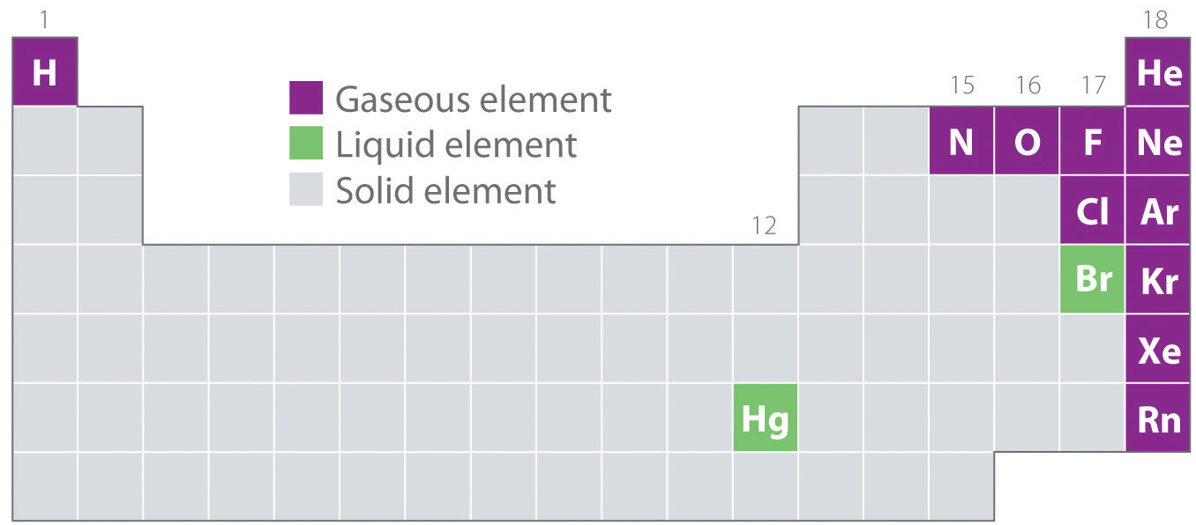
Periodic Table and States of Matter
Most Periodic Table models also indicate whether an element is a solid, liquid, or gas. Look at the diagram below.
Complete #15 on your Notes

Slide 34
Let’s Review the Basics of the Periodic Table
http://studyjams.scholastic.com/studyjams/jams/science/matter/periodic-table.htm

Slide 35
Reactivity of Elements
Atoms will often take, give, or share electrons with other atoms in order to have a complete set of electrons in their outer energy level.
Elements whose atoms undergo such processes are called Reactive and can combine to form compounds.
Since “Groups” [columns] are similar because they have the same number of electrons in their outer energy level, the Periodic Table is also organized by degree of reactivity.

Slide 36
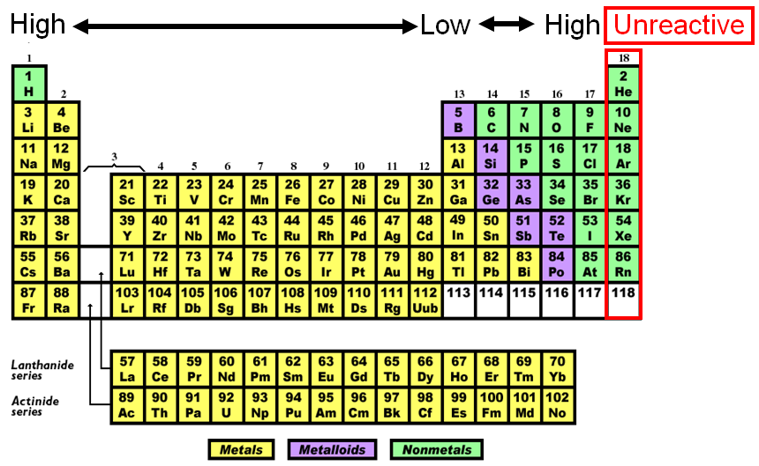
Reactivity of Elements

Slide 37
Reactivity of Elements
In general, Elements located on the left of the Periodic Table are most reactive metals, least reactive metals in the middle, and nonmetals on the right.

Slide 38
Distributed Summarizing
Elements whose atoms take, give, or share electrons are called Reactive and can combine to form compounds.
How could you compare Reactive Elements to people who are active on social media [Facebook, Instagram, Twitter, Snap Chat, etc]?
Using those thoughts, identify an Element that would be very active on social media. Identify an Element that would not join in social media. Explain Why.

Slide 39
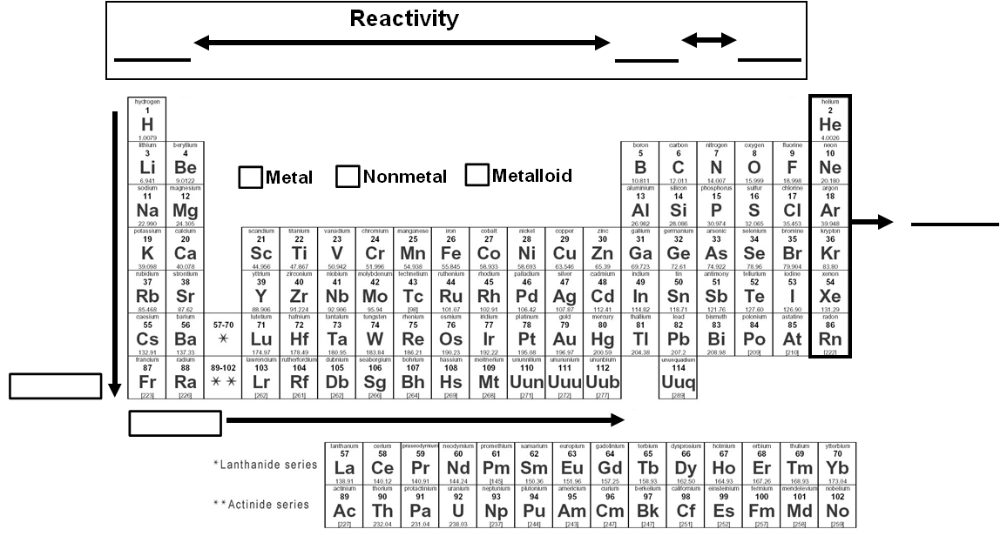
Complete #15 on your Notes
*Gas **Liquid

Slide 40
Summarizing Strategy
3-2-1
Name at least 3 ways the Periodic Table is organized
Identify the 2 numbers given for each element
Identify the main purpose of the Periodic Table

